Slide 1
WEEK 2 LECTURES
Two Ray model (CONTD) , Simplified pathloss model, Emperical model - Okumara, Emperical model - Hata model, Walfish and bertoni model, Piecewise linear model - log normal model
Courtesy:
Rappaport T.S, “Wireless Communications: Principles and Practice”, Pearson education.

Slide 2
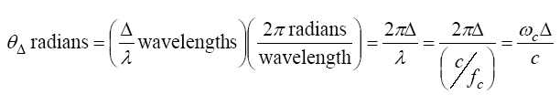
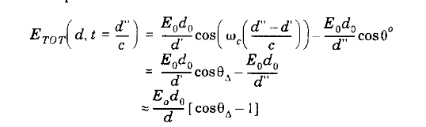
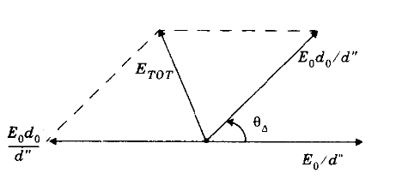
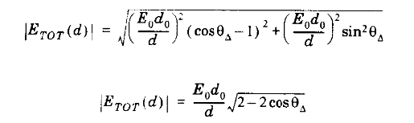
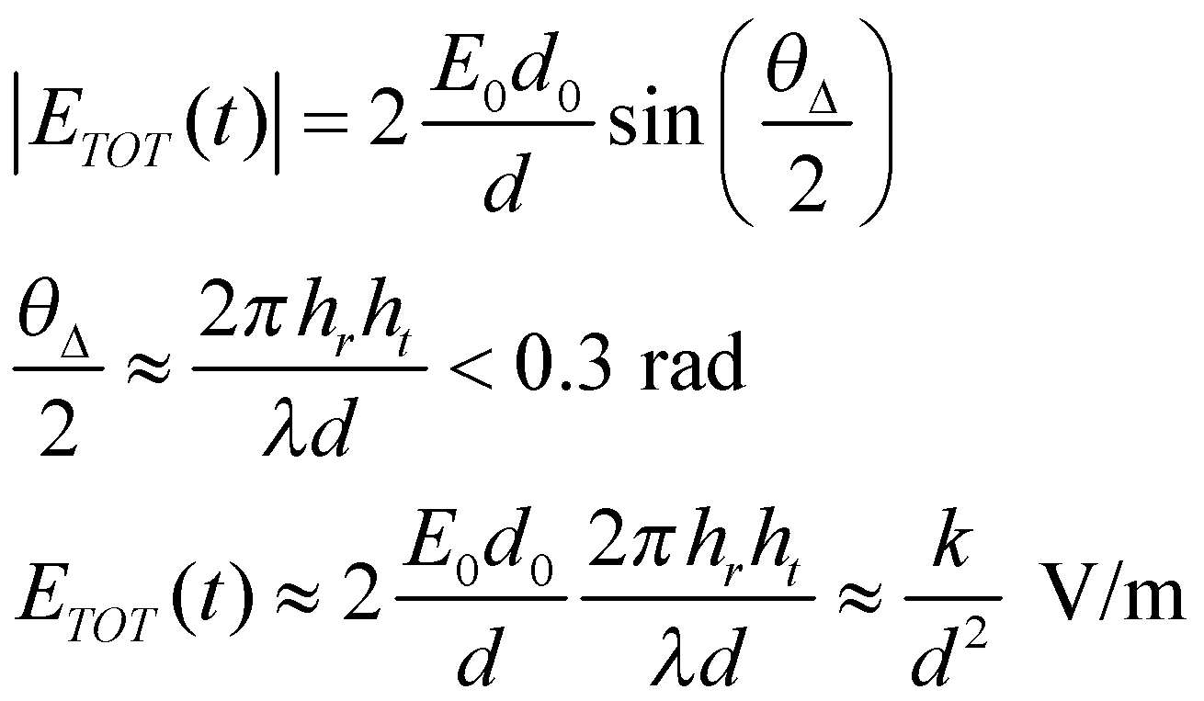
Two Ray model (CONTD), the phase difference between the two arriving signals is

Slide 3

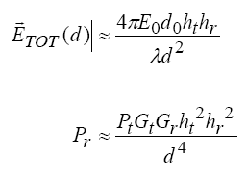
Two Ray model
note that the magnitude is with respect to a reference of E₀=1 at d₀=100 meters, so near 100 meters the signal can be stronger than E₀=1
the second ray adds in energy that would have been lost otherwise
for large distances it can be shown that

Slide 4
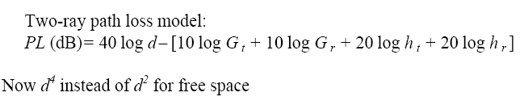


Two Ray model

Slide 5
Free Space (LOS) Model
d=vt
Path loss for unobstructed LOS path
Power falls off :
Proportional to 1/d²
Proportional to λ² (inversely proportional to f²)

Slide 6
Two Path Model
Path loss for one LOS path and 1 ground (or reflected) bounce
Ground bounce approximately cancels LOS path above critical distance
Power falls off
Proportional to d² (small d)
Proportional to d⁴ (d>d_{c})
Independent of λ (f)

Slide 7
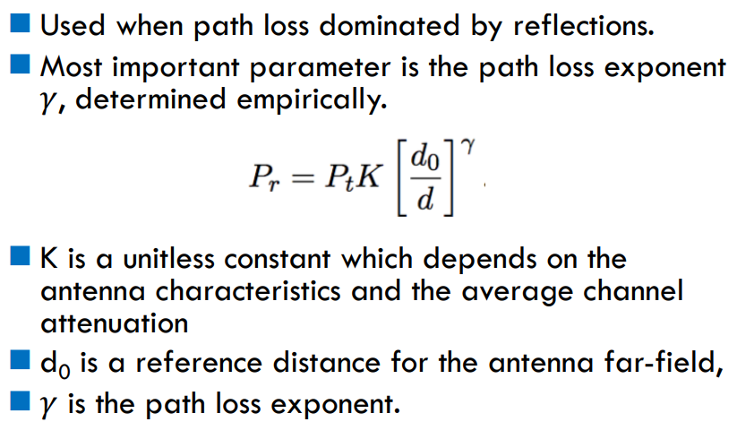
Simplified Path Loss Model

Slide 8
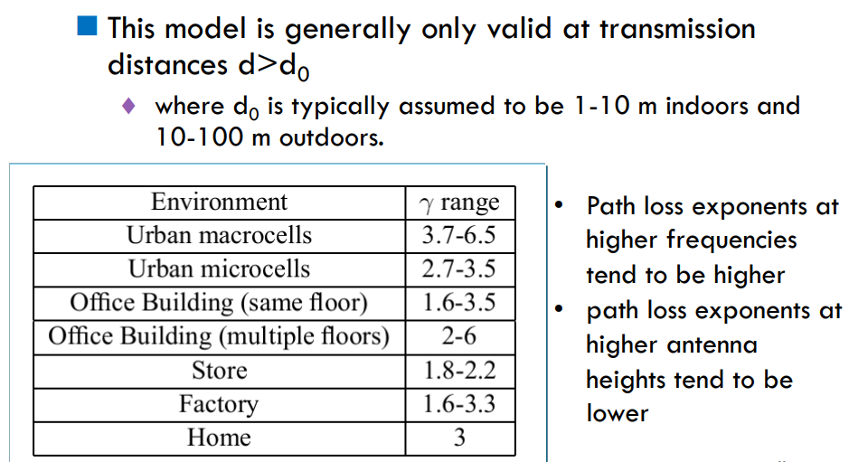
Simplified path loss model

Slide 9
Outdoor propagation Environment
Based on the coverage area, the Outdoor propagation environment may be divided into three categories
1. Propagation in Macro cells
2. Propagation in Micro cells
3. Propagation in street Micro cells

Slide 10
Outdoor propagation Environment
Macrocells versus Microcells
 | Macrocell | Microcell
Cell Radius | 1 to 20 km | 0.1 to 1 km
Tx Power | 1 to 10W | 0.1 to 1 W
Fading | Rayleigh | Nakgami Rice
RMS Delay Spread | 0.1 to 10 µs | 10 to 100ns
Max. Bit Rate | 0.3 Mbps | 1 Mbps

Slide 11
Empirical Models
Commonly used in cellular system simulations
Okumura model
Empirically based (site/freq specific)
Awkward (uses graphs)
Hata model
Analytical approximation to Okumura model
Cost 231 Model:
Extends Hata model to higher frequency (2 GHz)
Walfish/Bertoni:
Cost 231 extension to include diffraction from rooftops
Piece wise linear model/ Slope model

Slide 12
Outdoor propagation Models
Outdoor radio transmission takes place over an irregular terrain.
The terrain profile must be taken into consideration for estimating the path loss
e.g. trees buildings and hills must be taken into consideration
Some common models used are
Longley Rice Model 1960s
Okumura Model 1968
Hata model 1970s

Slide 13
Okumura Model
In 1968 Okumura did a lot of measurements and produce a new model.
The new model was used for signal prediction in Urban areas.
Okumura introduced a graphical method to predict the median attenuation relative to free-space for a quasi-smooth terrain
The model consists of a set of curves developed from measurements and is valid for a particular set of system parameters in terms of carrier frequency, antenna height, etc.

Slide 14
Okumura Model
First of all the model determined the free space path loss of link.
After the free-space path loss has been computed, the median attenuation, as given by Okumura’s curves has to be taken to account
The model was designed for use in the frequency range 200 MHz to 1920 MHz and mostly in an urban propagation environment.
Okumura’s model assumes that the path loss between the TX and RX in the terrestrial propagation environment can be expressed as:

Slide 15
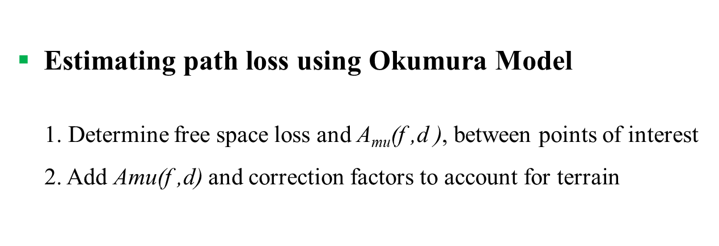
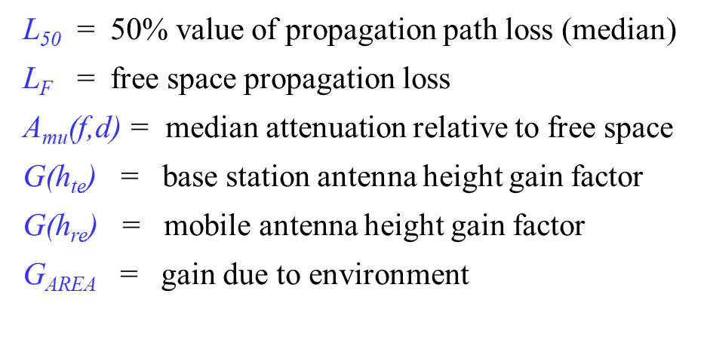
Okumura Model
Estimating path loss using Okumura Model
1. Determine free space loss and A_{mu}(f ,d ), between points of interest
2. Add Amu(f ,d) and correction factors to account for terrain
‹#›

Slide 16
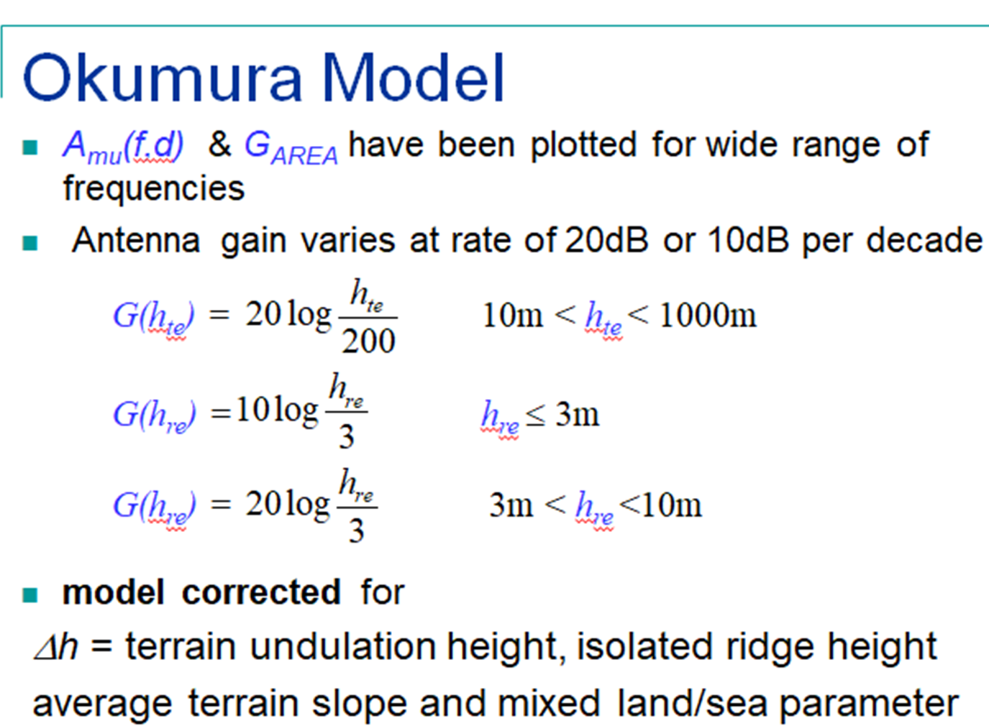

Slide 17
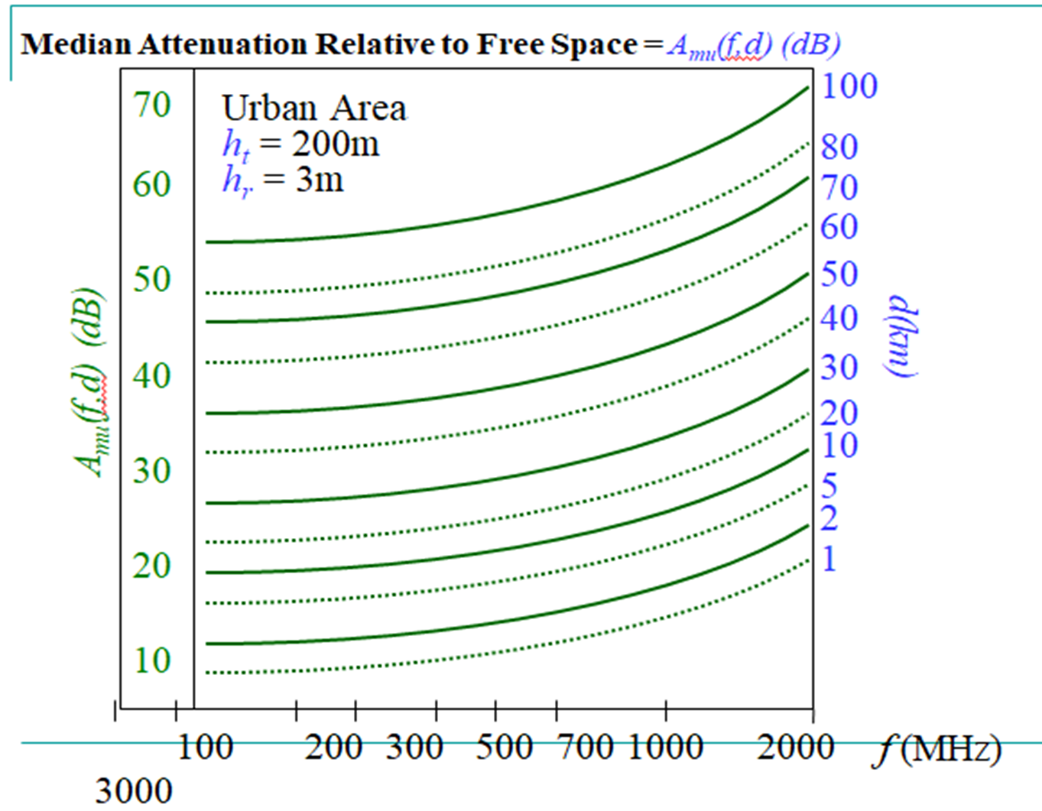

Slide 18
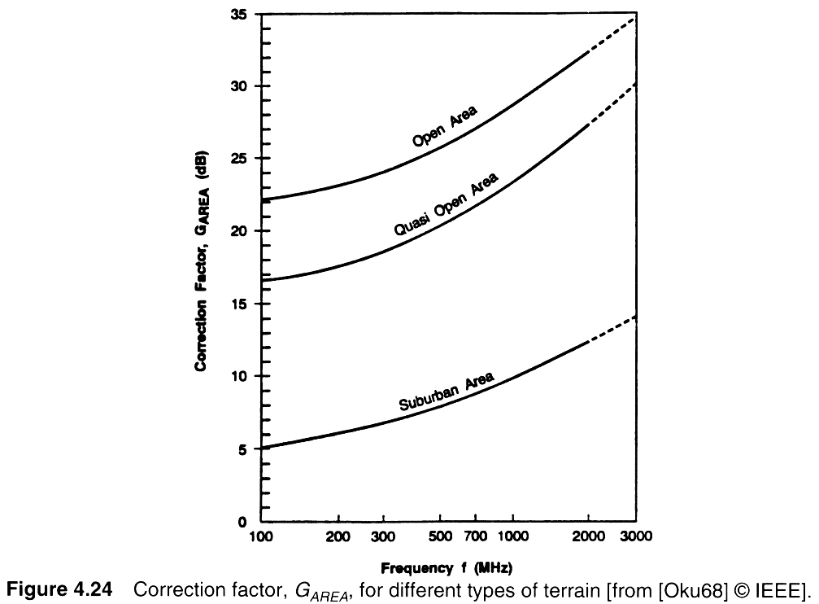
Correction Factor G_{AREA}

Slide 19
Hata Model
Most widely used model in Radio frequency.
Predicting the behavior of cellular communication in built up areas.
Applicable to the transmission inside cities.
Suited for point to point and broadcast transmission.
150 MHz to 1.5 GHz, Transmission height up to 200m and link distance less than 20 Km.

Slide 20
Hata Model
Hata transformed Okumura’s graphical model into an analytical framework.
The Hata model for urban areas is given by the empirical formula:
L50, _{urban} = 69.55 dB +26.16 log(f_{c})- 3.82 log(h_{t}) -a(h_{r}) + (44.9 − 6.55 log(h_{t})) log(d)
Where L50, _{urban} is the median path loss in dB.
The formula is valid for
150 MHz<=f_{c}<=1.5GHz,
1 m<=h_{r}<=10m, 30m<=h_{t}<=200m,
1km<d<20km

Slide 21
Hata Model
The correction factor a(h_{r}) for mobile antenna height hr for a small or
medium-sized city is given by:
a(h_{r}) = (1.1 logf_{c} − 0.7)h_{r} − (1.56 log(f_{c}) − 0.8) dB
For a large city it is given by
a(h_{r}) = 8.29[log(1.54h_{r})]² − 1.10 dB for f_{c} <=300 MHz
3.20[log (11.75h_{r})]² − 4.97 dB for f_{c} >= 300 MHz
To obtain path loss for suburban area the standard Hata model is modified as
L₅₀ =L₅₀(urban)-2[log(f_{c}/28)]²-5.4
For rural areas
L₅₀ =L₅₀(urban)-4.78log(f_{c})²-18.33logf_{c} -40.98

Slide 22
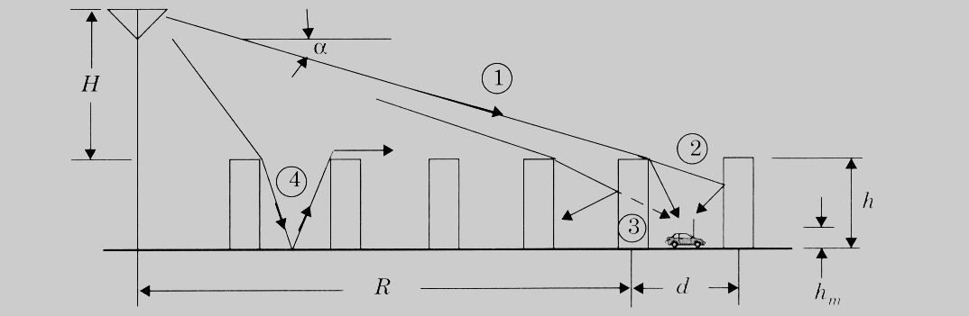
Walfisch and Bertoni’s Model
This model uses diffraction to predict average signal strength at street level. The model considers the path loss to be the product of three factors:
Q2 reflects the signal power reduction due to buildings that block the receiver at street level and P1 is based on the signal loss from the rooftop to the street due to diffraction.
(Wireless Communications by Theodore Rappaport)
Propagation geometry for model proposed by Walfisch and Bertoni
Notes:
Fig. 2.16

Slide 23
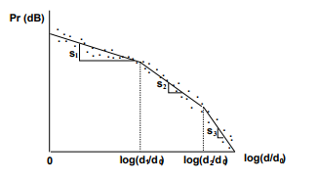

Piece wise linear model
Piecewise Linear Model for Path Loss.
A piecewise linear model with N segments must specify N − 1 breakpoints d1,...,dN−1 and the slopes corresponding to each segment s1,...,sN .
Dual-slope model

